Slide 1
Doctor Appointment Application
PIP104 University Project-II
Final Review PPT
Batch Number:CSE-G70
Roll Number | Student Name
20201CSE0404 | G.Lakshmi Prasana
20201CSE0387 | Madhusmita Sahoo
20201CSE0408 | Basireddy Pavan Kumar Reddy
Under the Supervision of,
Ms.Ayesha Taranum
Assistant Professor
School of Computer Science & Engineering
Presidency University

Slide 2
Introduction
Doctor appointment booking application has improved the efficiency and efficacy of clinics, hospitals, and online healthcare marketplaces while simplifying operations. Patients can use these applications to communicate with doctors online.
Patients can use doctor appointment booking mobile applications to engage with medical providers via an online platform. In other words, people receive virtual consultations with doctors from the comfort of their own homes and at their desired times.
For healthcare practitioners, their clinic’s mobile app offers a solution to a variety of challenges. The most important of these are regularly managing the staff’s hours booking arrangements. The online Doctor appointment mobile app is an effective approach to better manage arrangements.
These applications function in two ways: as a patient and as a doctor. Let’s see how it goes for both of them in the real world.

Slide 3
Literature Review
Mr. Doc: A Doctor Appointment Application System.Malik, Shafaq & Bibi, Nargis & Khan, Sehrish & Sultana, Razia & Rauf, Sadaf
Design and Implementation of a Patient Appointment and Scheduling System. John Lekan, Akinode.
Web-Based Medical Appointment Systems: A Systematic Review. Peng Zhao, Illhoi Yoo, Jaie Lavoie,James Lavoie, Eduardo Simoes.)
A Literature review of Measurement of Health Literacy in India. Samir Barve

Slide 4
Literature Review
Software and Tools Used:
1. HTML
2.CSS
3. JAVASCRIPT
4. BOOTSTRAP
5. Django
6. PYTHON
7. Windows 8.0, 8.1 and 10/11 (32-bit and 64-bit)

Slide 5
Proposed Method
The proposed work focuses on implementing an Online Doctor Appointment Website. The basic function of this website is to help patients book appointments easily and also allow doctors to keep a track of these appointments.. The Waterfall Model has been used here for implementation.
The system is implemented by using HTML and CSS for the frontend , which creates a dynamic UI which is easy to understand and can be navigated without any hassle.Here, PHP ( Hypertext Preprocessor) acts as the server side for managing the databases and session tracking related to patients , doctors, their details, the various appointments booked, prescriptions etc. An object-oriented programming language, i.e, JavaScript is used to enable dynamic interactivity so that the user can interact with the web pages without having to reload every time. The whole framework has been developed using the Windows 8/10 operating system.

Slide 6
Objectives
24/7 Access to Health Care Services
Choice of Scheduling and rescheduling appointments anytime, anywhere
Real-time communication with their care team
Pay bills Securely, Order Medicines, and Record of Medical History (if these functionalities are offered)
Better staff-appointment management
Easy going administrative tasks
Avoid the obstacle of overbooking
Performance and Productivity Insights.

Slide 7
Methodology
Project Name: Doctor Appointment Management System Project(Using Django)
Web Browser - Edge, Google Chrome, Mozilla
Software - VS Code
Database - SQLite
Language Used - Python, Django
User Interface Design - HTML,CSS,BOOTSTRAP,JAVASCRIPT

Slide 8




Timeline of Project
Review-0: PPT of the Project overview.
Review-1:Partial Frontend Output and showing ppt
Review-2:
Review-3:

Slide 9
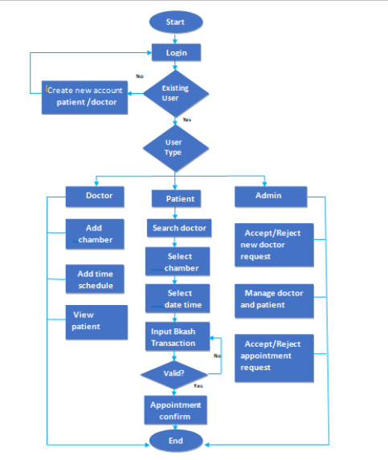
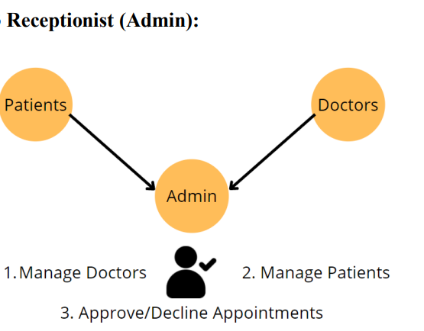
USE CASE DIAGRAM

Slide 10
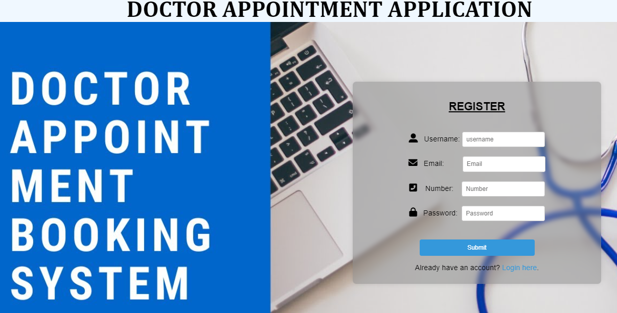
Expected Outcomes

Slide 11
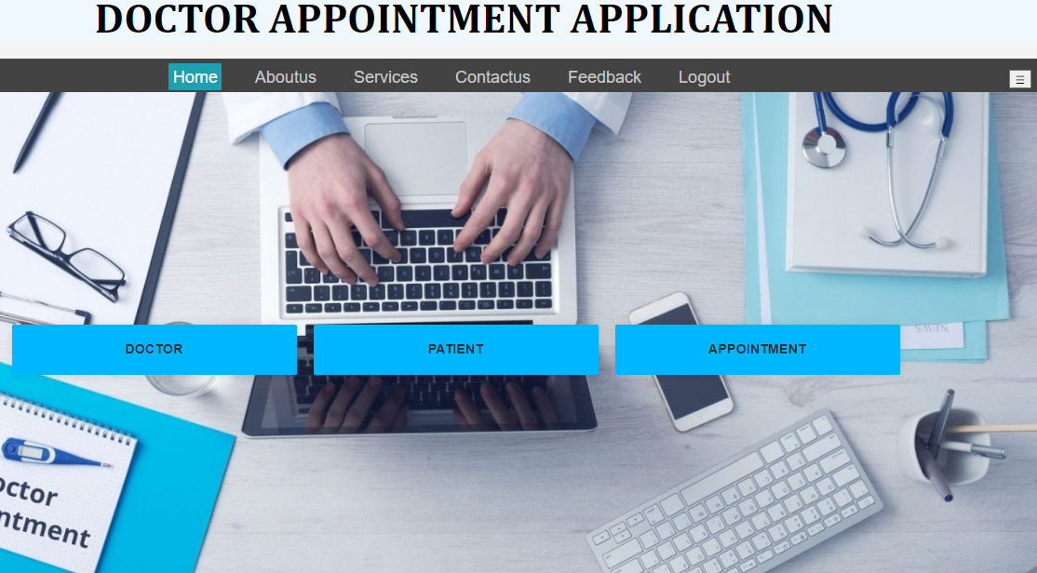
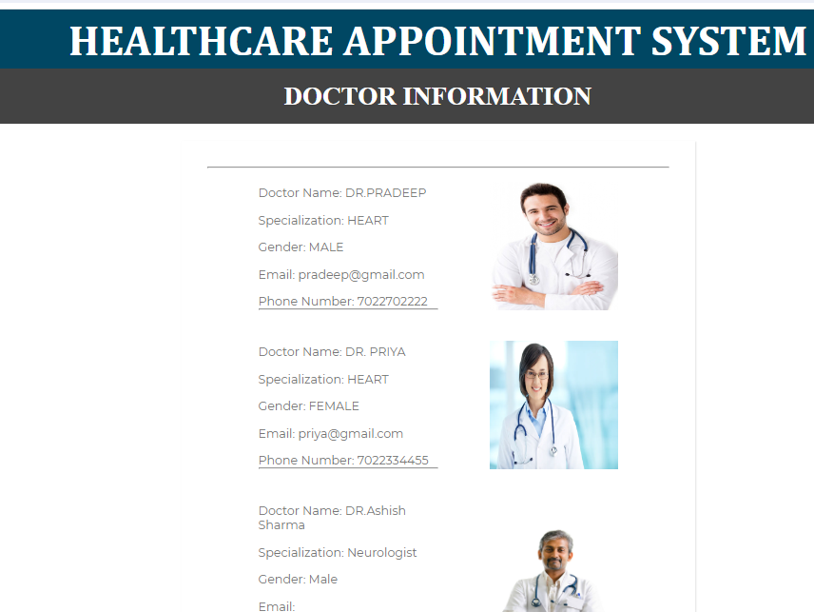
Expected Outcomes

Slide 12
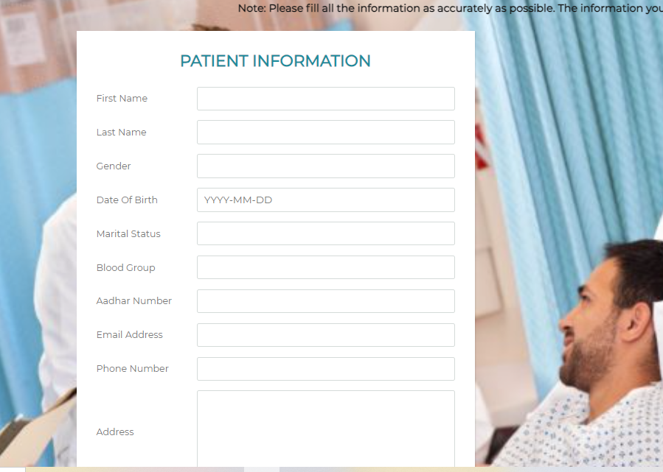
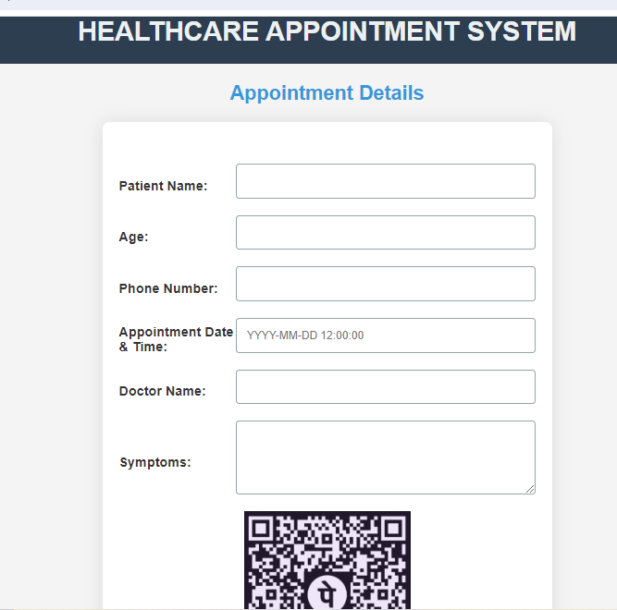
Expected Outcomes

Slide 13
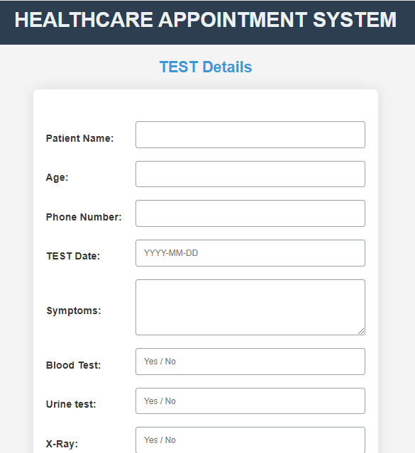
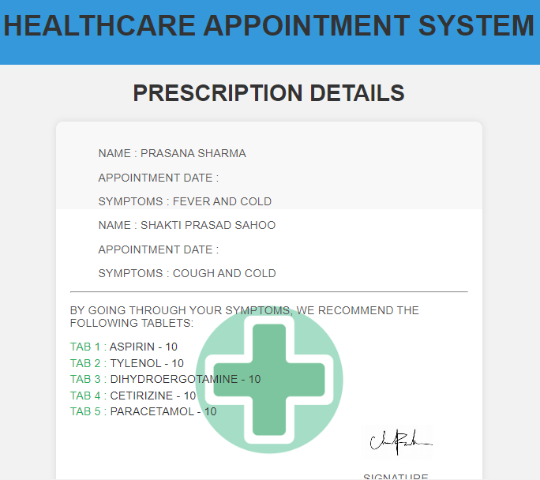
Expected Outcomes

Slide 14
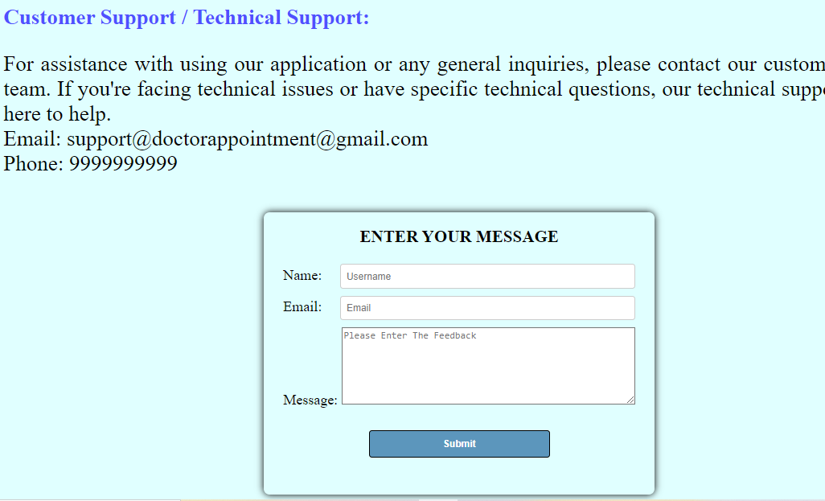
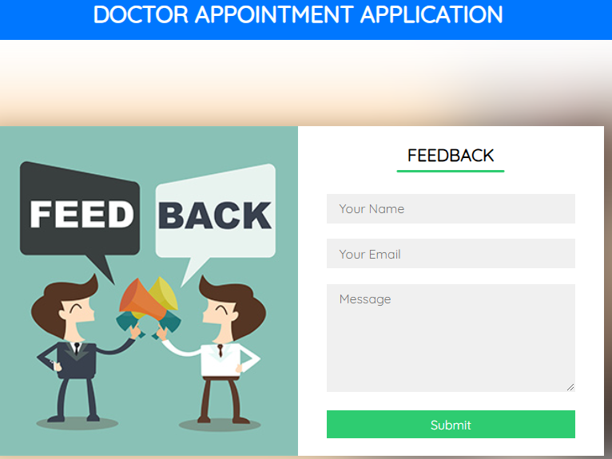
Expected Outcomes

Slide 15
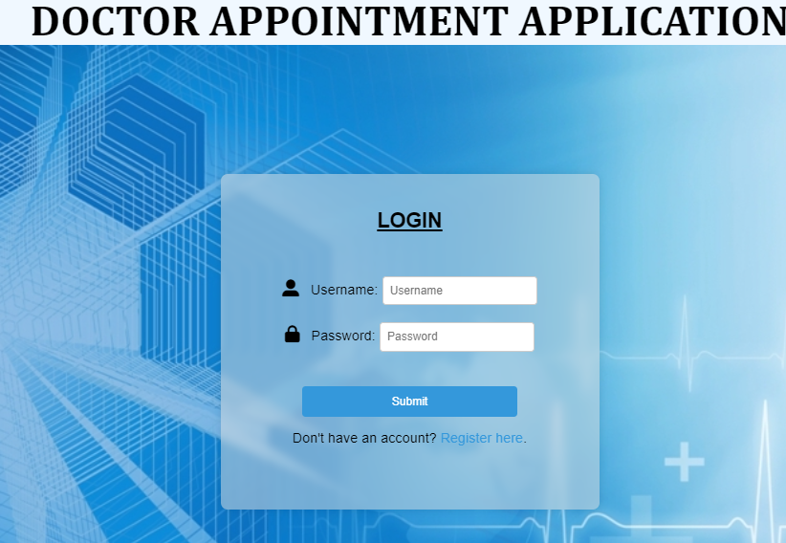
Expected Outcomes

Slide 16
Conclusion
This is a web-based system that deals with the issue of managing and booking appointments according to user’s choice/necessity. Patients can select doctors based on their medical needs and they can look at their details and reviews to learn more. Hence this project offers an effective solution where users can view various booking slots available and select the preferred date and time.
This reduces physical waiting time and not only saves time for the users but also makes the appointment process more efficient.
With this application the doctor can alert his own schedule. Hospitals can easily manage their registration and appointment process and monitor the flow of patients to the doctors. The admin manages both the doctors and patients and creates a seamless experience for all the people involved.

Slide 17
References
[1]. Malik, Shafaq & Bibi, Nargis & Khan, Sehrish & Sultana, Razia & Rauf, Sadaf. (2016). Mr. Doc: A Doctor Appointment Application System. International Journal of Computer Science and Information Security,. 14. 452-460.
[2]. John Lekan, Akinode. (2017). Design and Implementation of a Patient Appointment and Scheduling System. 4. 16-23. 10.17148/IARJSET.2017.41203.
[3]. N. V. Chaudhari, Akshay Phadnis, Prajakta Dhomane, Jayshree Nimje, Akansha Sharma. (2017). Android Application for Healthcare Appointment Booking System. Imperial Journal of Interdisciplinary Research (IJIR), Vol-3, Issue-3, ISSN: 2454-1362.
[4]. S.Hema Kumar, J.Uday Kiran, V.D.Ambeth Kumar, G.Saranya,Ramalakshmi V, INTERNATIONAL JOURNAL OF SCIENTIFIC & TECHNOLOGY RESEARCH VOLUME 8, ISSUE 09, SEPTEMBER 2019,ISSN 2277-8616
[5]. Sonal G. Shelwante , Anshuli Thakare, Karishma Sakharkar , Akshta Birelliwar , Karuna Borkar," Smart Health Doctor Appointment System",IJRESM, Volume-2, Issue-2, February-2019. ISSN 2277-8616

Slide 18
Thank You

